Slide 1

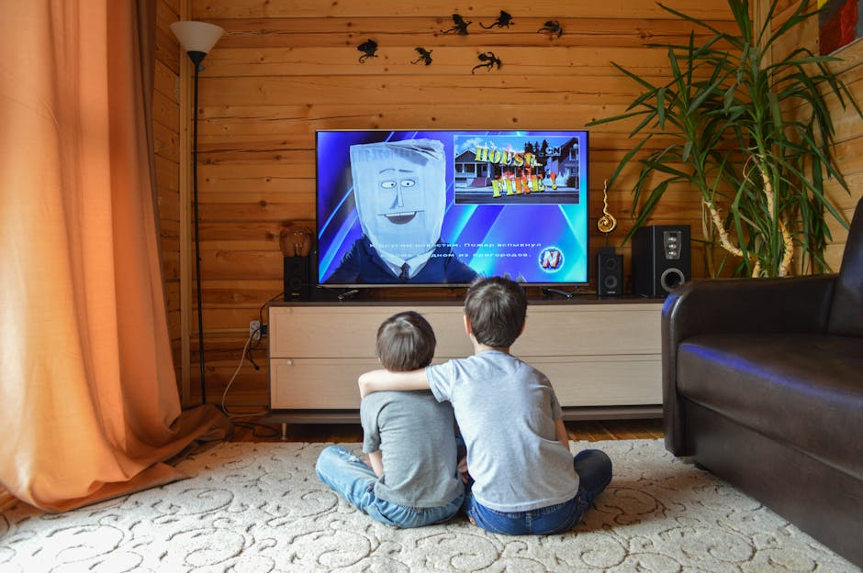

Children’s TV Viewing Trends 2023 UK Analysis
Based on Weekly BARB Data for Ages 4–15
Prajakta Zaavde

Slide 2
Content Overview
763 shows and 186 films aired in 2023
462 shows and 153 films aired on weekends
Average Runtime:
Shows: 13 minutes 31 seconds.
Films: 1 hour 46 minutes 22 seconds
ATS data, Kids spent an average of 46 minutes per week watching children’s TV channels.
POP channels have viewing sessions exceeding 90 minutes more than 5 times over the 52 weeks.
Over 64% of children who watch TV tuned in to kids channels for at least 3 minutes weekly.

Slide 3
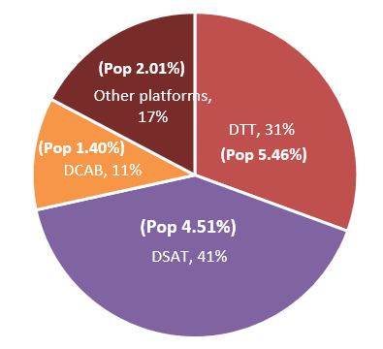
TV & Channel Performance
Total TV viewing platform distribution
Top Channels:
CBeebies dominates with a 45.84% share and weekly peaks >600K viewers.
Narrative channels (Pop, Tiny Pop, Pop Max) averaged 19.66% share, peaking at 24.93% in October.
Underperformers:
Cartoonito (1.37M annual avg. (0.83%)) and Boomerang (2M (2.08%)) struggle with audience alignment.
Nick Jr. 2 had zero film viewership in June.
Average monthly watch time for DSAT for kids TV is 56 mins.

Slide 4
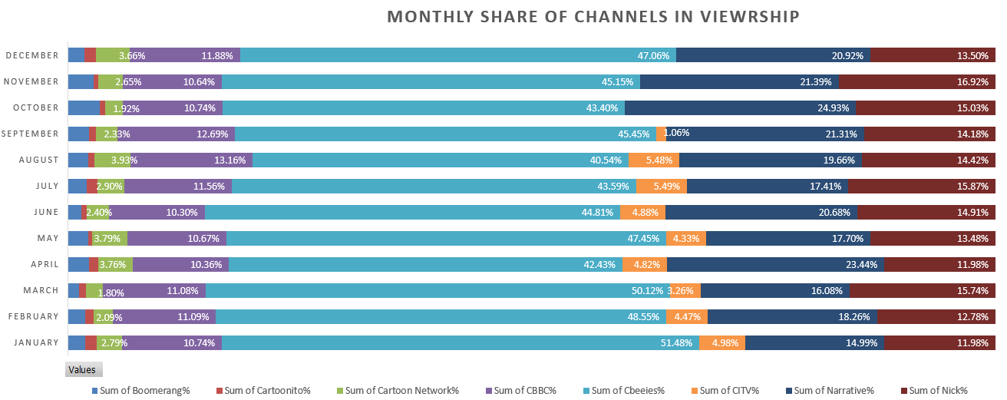

Slide 5
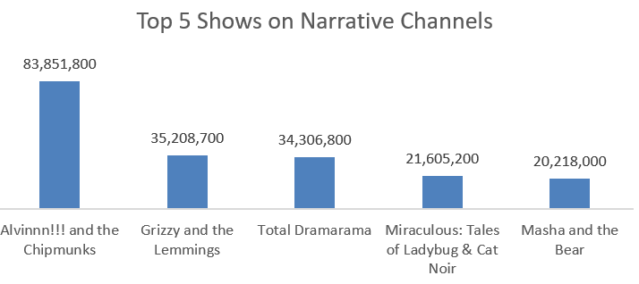
Shows Insights
Top 5 shows on narrative channels remain largely unchanged throughout December, even during the Christmas month.
It is observed, top 10 shows overall based on audiences, 50% of them have higher frequency of airing per week.
However, it was seen that the higher the frequency, the lower the run time.

Slide 6
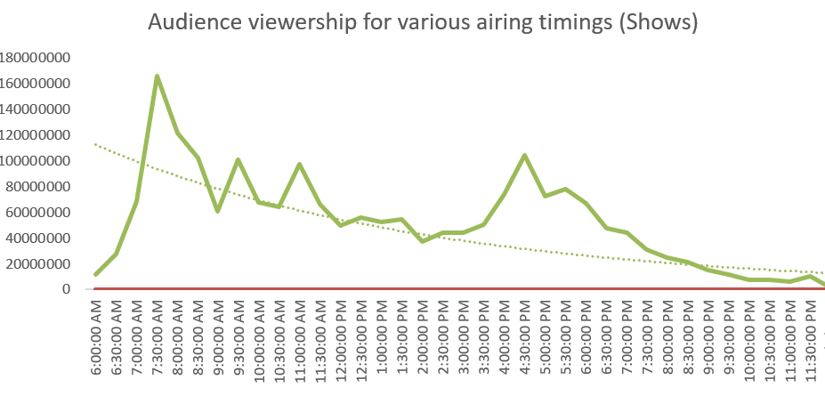
Viewing Patterns for shows by Time Slot
Morning (7:00–7:30 AM): Viewership peaked with a 147% increase as children prepared for school.
Afternoon (4:00 PM): Audience rose by 47% as children returned home, marking another key engagement period.
Declines:
9:00 AM: A 41% drop, aligning with the start of school hours.
Post-6:00 PM: Gradually decreases towards bedtime.

Slide 7
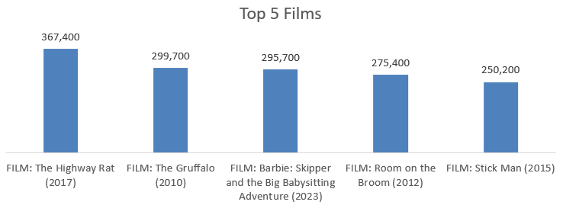
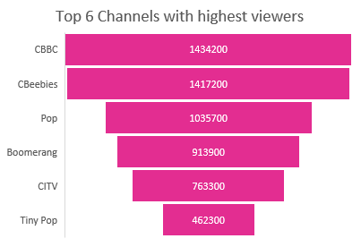
Films Insights
CBBC, Cbeebies, Pop, Boomerang, CITV, and Tiny Pop emerged as key players in film viewership, successfully capturing large audiences with engaging content.
For the holiday season the audience grew by 462%.
For Pop channels as well there is almost 3000% growth from November to December.
Frequency of Airing for top 10 movies by audience showed that 60% of movies had aired more than once per week.

Slide 8
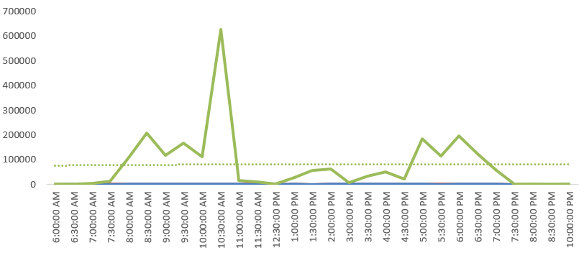
Viewing trends in time-slots for films for holiday season (Nov, Dec, Jan):

Slide 9
Top insights:
Time Slot Engagement: Morning (7:00–7:30 AM) viewership spikes by 147%, while afternoon (4:00–5:00 PM) sees a 47% rise. Post-8:00 PM viewership drops sharply, aligning with children’s routines.
Channel Performance: CBeebies leads with a 45.84% audience share and weekly peaks over 600K viewers, while narrative channels (Pop, Tiny Pop, Pop Max) average 19.66% with October highs at 24.93%.
Weekend Preference: 60.6% of shows and 82% of films air on weekends, reflecting strong audience demand during non-school days.
Seasonal Trends: December viewership surges by +462% (Christmas holidays) from the viewers in November, while March -88% declines align with school routines for films. Viewer recovery begins in September and grows in the year’s latter half.
Film Engagement: Peak times for films are 9:00 AM (695K viewers) and 5:00 PM (970K viewers). Scheduling gaps, like zero viewership on Nick Jr. 2 in June, highlight promotional or alignment issues.

Slide 10
Thank You

